Slide 1
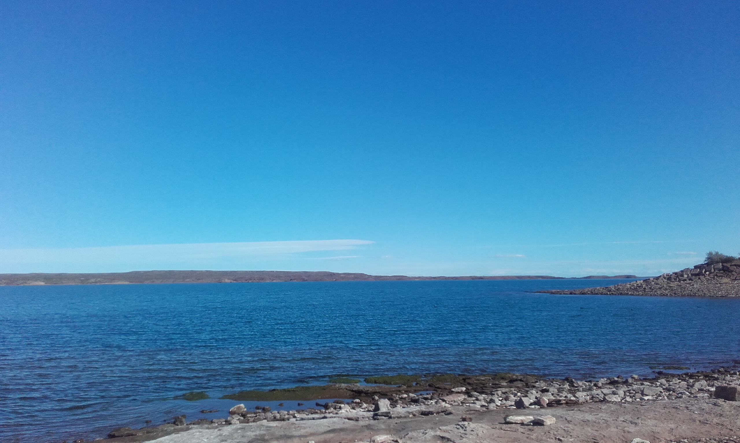
30 years with the UN Convention on the rights of the Child
International OMEP Conference
Migrant children in Czech preschools
Brno, 12 November 2019
Ingrid Engdahl, Ass. Professor, Stockholm
VP for OMEP in Europe
ingridengdahl@gmail.com

Slide 2
OMEP
Organisation Mondiale pour l’Éducation Préscolaire
World Organisation for Early Childhood Education

Slide 3
OMEP started in Prague 1948
Initiative with UNESCO
Now in more than 70 countries
28 in Europé
2018 returning to Prague
70th anniversary
Lady Majorie Allen of Hurtwood, England
Alva Myrdal, Sweden 1948 in Prague

Slide 4
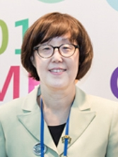
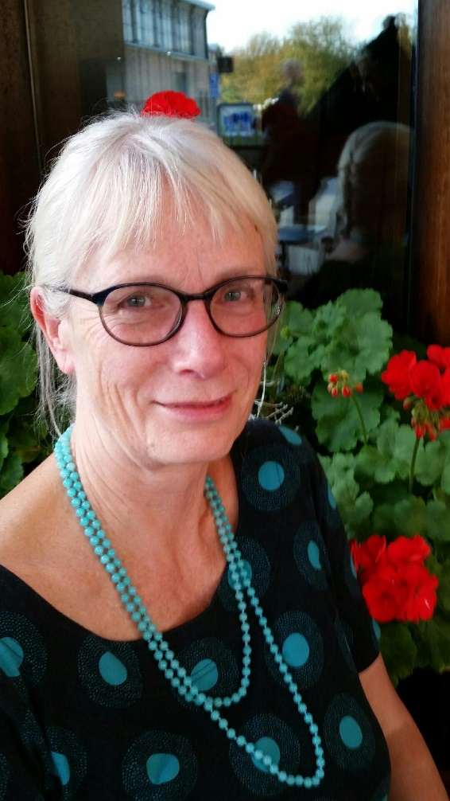
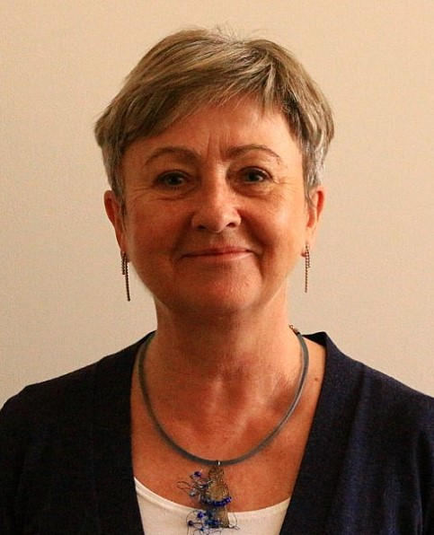
OMEP World President
Eun-Hye Park
Ewha Womans University, Seoul, Korea
OMEP VP for Europe
Ingrid Engdahl
Stockholm, Sweden
OMEP President in Czech Rep.
Milada Rabušicová
Masaryk University, Brno
OMEP was an active participant in the writing of the UNCRC and continuously
Today OMEP stands firmly on two tasks for children Birth – 8
Implementing the UNCRC
Reorienting towards a sustainable future

Slide 5
Human Rights for ALL children
The UNCRC is for all children and youths from birth to 18 years, in the whole world.
All children have the right to information and knowledge about their rights.
20th of November 2019 – 30th anniversary

Slide 6
State Parties sign and ratify
The official institutions and employees in the country
State parties shall ensure to the maximum extent possible
to ensure children these rights and to protect them from all forms of exploitation and violence.
To promote, to provide and to protect

Slide 7
Children have become citizens
After 30 years with the convention:
the first intention of UNCRC that child rights should be incorporated into national legislation has been achieved
children today in many countries, are recognized as citizens with their own rights.
not all rights for children specified in UNCRC are respected or addressed
(Engdahl, 2019)

Slide 8
What is the UNCRC?
54 articles (1989)
3 Optional protocols 24 General comments
UN Committee on the Rights of the Child (CRC) in Geneva (CR August 13, 2018)
Concluding observations in return
(CR February 1, 2019)

Slide 9
UN Convention on the Rights of the Child
Four articles represent the ‘General Principles’ but the UNCRC should be holistically understood as one document.
Non-discrimination (article 2)
Best interest of the child (article 3)
Right to life, survival and development (article 6)
Right to be heard (article 12)

Slide 10
Odstranění diskriminace (článek 2)
Úmluva o právech dítěte přiznává všem dětem bez ohledu na jejich původ, víru či schopnosti veškerá dětská práva. Nezáleží na tom, kde dítě žije, jakým jazykem hovoří, co dělají jeho rodiče, zda je dívka či chlapec, z jakého kulturního zázemí pochází, kolik má jeho rodina peněz. Žádné dítě by nemělo být znevýhodněno.
All children have the same value
Children who have fled or moved to another country have the same rights as children in the new country

Slide 11
Preschools are meeting places
The preschool is a social and cultural meeting place
promote children’s understanding of the value of diversity
as well as an interest in local culture,
an awareness of different living conditions and cultures
to develop an ability to understand and empathise with other people’s conditions and values

Slide 12
Nejlepší zájem dítěte (článek 3)
Zájem dítěte musí být zohledněn při jakékoliv činnosti týkající se dětí. Všichni dospělí by měli dělat rozhodnutí podle toho, co je nejlepší pro děti, jelikož tato rozhodnutí je přímo ovlivňují. Toto pravidlo se vztahuje také na finanční politiku země, na legislativu, na rozhodnutí týkající se budoucnosti jako takové.
Maybe the most well-known article
But hard to fulfil

Slide 13
…in the best interests …
Art. 3 often causes a dilemma between
child perspective from the adults
children’s perspective from children
Teachers should be
striving to get close to children
striving to understand the world of children

Slide 14
Analysing the proposals
BEFORE the decision is made
Children’s voices shall be included in the analysis of the proposal.
What is the proposal about?
Look into the arguments for and against
Which children are involved?
What do they say? In group, the individuals?
What would be in the best interests of the child?
Sometimes, there are things deemed to be more important than what’s best for the children.
But the politicians always must show that they have considered the children’s best interests.

Slide 15
Právo na život, přežití a rozvoj (článek 6)
Děti mají právo žít. Vlády jednotlivých zemí odpovídají za to, že děti mohou žít a vyrůstat ve zdravém a bezpečném prostředí.
This article is about security, love, food, healthcare, a home, possibilities to play, to go to preschool and school.

Slide 16
OMEP Declaration Lisbon 2019
However, today too many children in Europe and around the world are living under dreadful circumstances.
Children in migration are among the most vulnerable, and on the doorsteps to Europe, there are children living in camps, even imprisoned. These children are living in extreme conditions, calling for immediate action.
Governments have a special responsibility towards these children, to bring them to safety, to help and support them.
For young children, every single day is of vital importance for their physical and mental health.

Slide 17
Respekt k názoru dětí (článek 12)
Když dospělí dělají rozhodnutí, která ovlivní život dětí, mají děti právo se k tomuto rozhodnutí vyjádřit a jejich názor by měl být brán v potaz. To však neznamená, že děti mohou rodičům říkat, co mají dělat. Úmluva o právech dítěte se snaží motivovat dospělé, aby naslouchali dětem a zahrnuli je do rozhodovacího procesu - nedává v žádném případě dětem nadvládu nad dospělými.
Adults shall listen to children.
Authorities and courts shall ask children about their opinions and listen to the children before they make decisions affecting the child.
It could also mean that teachers shall ask the children before making decisions.
Politicians in a municipality shall ask children what they think before deciding in affairs concerning children.

Slide 18
Article 13 Freedom of expression
Every child must be free to express
their thoughts and opinions and
to access all kinds of information,
as long as it is within the law.

